Slide 1

Basic Concepts in Deep Learning
Julian Schulz 2024

Slide 2
Was ist Machine Learnung?
Klassische Programmierung
Machine Learning
Explizite Regeln werden von Menschen geschrieben
Jeder Schritt muss definiert werden
Man kann nur Lösungen implementieren, die man selber „versteht“
Computer "lernt" aus Beispielen
Wir definieren nur Input und gewünschten Output
Programm findet selbst Muster und Regeln
Man kann Lösungen finden, die man nicht bottom-up „versteht“

Slide 3
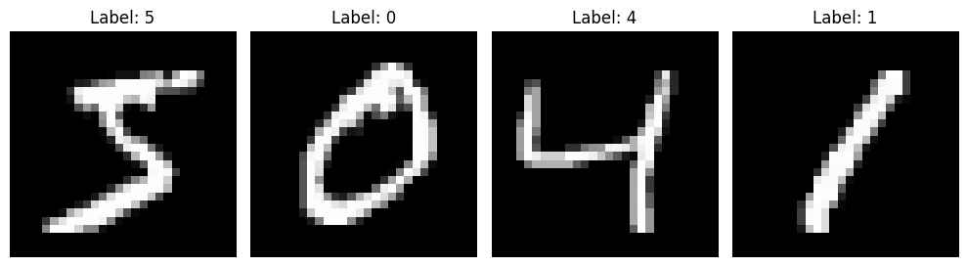
Deep Learning
Differentiable difference Metric “loss”
Eine spezifische Art von Machine Learning
Gradient step
Program
40% “4”
30% “8”
30% “3”
4
5
0
Input
Wanted
Output
Actual
Output
Differentiable space of possible programs

Slide 4
How to make Programs differentiable?
Programs are defined as a fixed set of operations with differentiable numbers “weights”
.5
Continuously changable
.4
.6
.1
Running through nonlinear function
“activation function”
The numbers going through these operation are called “activations”
.2
.2
Multiply with matrices “weights”
Adding numbers “biases”
.2
Input
Output
Differentiable space of possible programs

Slide 5
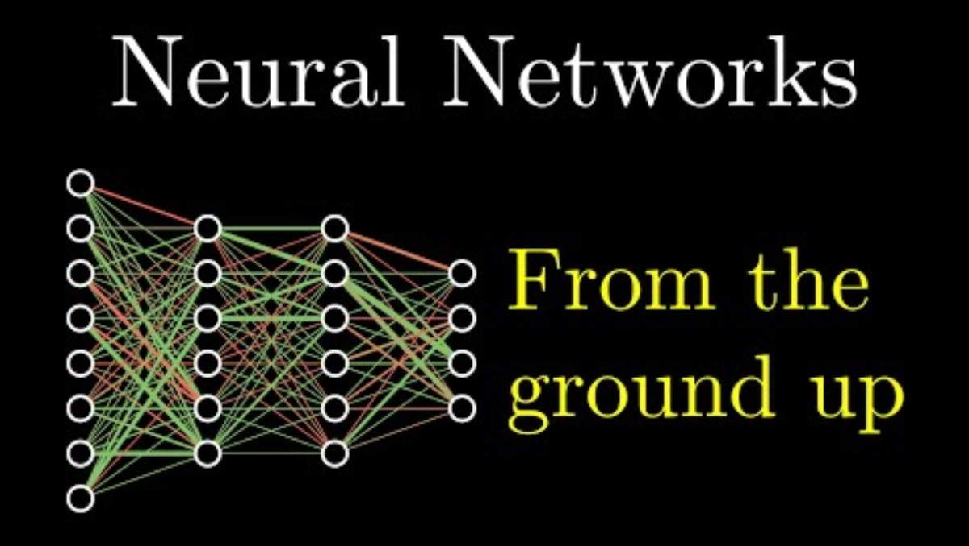

Slide 6
Loss functions – How do we judge output?
We know what the output should be:
Supervised Learning
We know (some) properties of good output:
Unsupervised learning
We can recognize good outputs after the fact
Reinforcement learning

Slide 7
Supervised Leanring
Example:
Label Images
original labels need to be done by hand
How to quantify the “Loss”:
Most often: Negative Log Likelihood of the correct output
You can also use normal probability, but here, differential progress is hard to see
Where the correct output is distribution, this generalizes to KL divergence
Where the output is not class-likelihood but “position”, often square distance is used

Slide 8
Unsupervised Learning
Example:
Labelling Songs
Song listened to by the same people should have the same lable
This does not define a “should-lable” for each song, but we can judge label distributions after the fact
How to quantify the “Loss”:
This heavily depends on the property we want out outputs to have

Slide 9
Reinforcement Learning
Example:
Playing Chess
We don’t know what the “correct chess move” in each position is
We can easily judge end states: was this game lost or won?
How to quantify the “Loss”:
Lots of different approaches
Often: Have one Network predict in how good our state is (Q Network), have another network predict what move would lead to a higher predicted state quality (Actor)
Update both networks during training
Big difficulty: How to deal with sparse feedback?
We will not cover this in this course

Slide 10
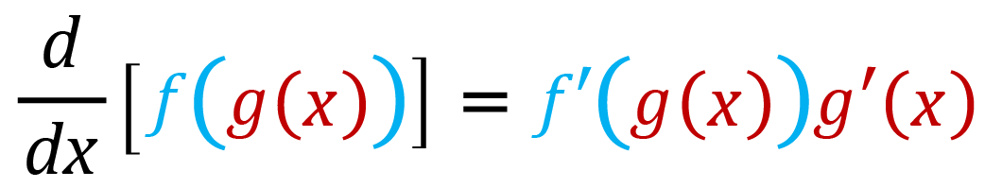
How to calculate gradients
All Elements of the Neural Network are executed after each other
“Computational Graph”
Gradients can be calculated via the Chainrule
That means, that gradients are easy to calculate (separately for each part of the neural network
It also means, that if gradient vanishes anywhere, no updates are made to earlier parts

Slide 11
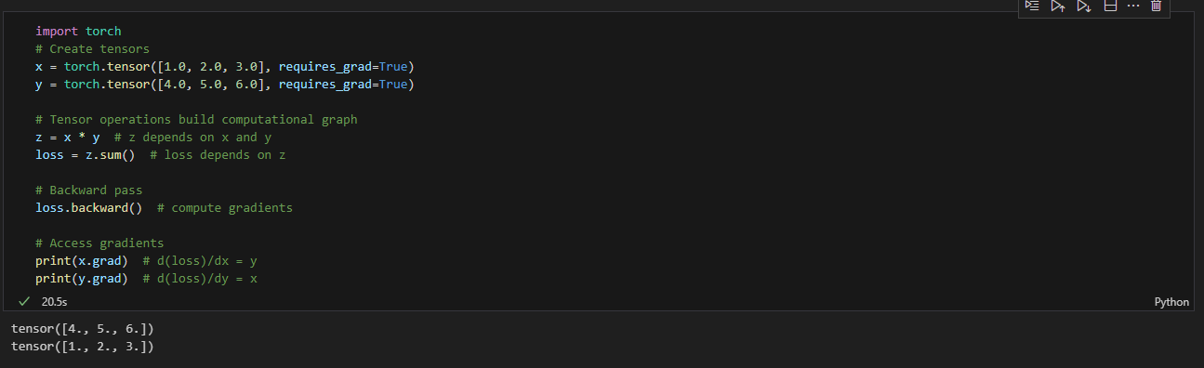
Pytorch Implementation

Slide 12
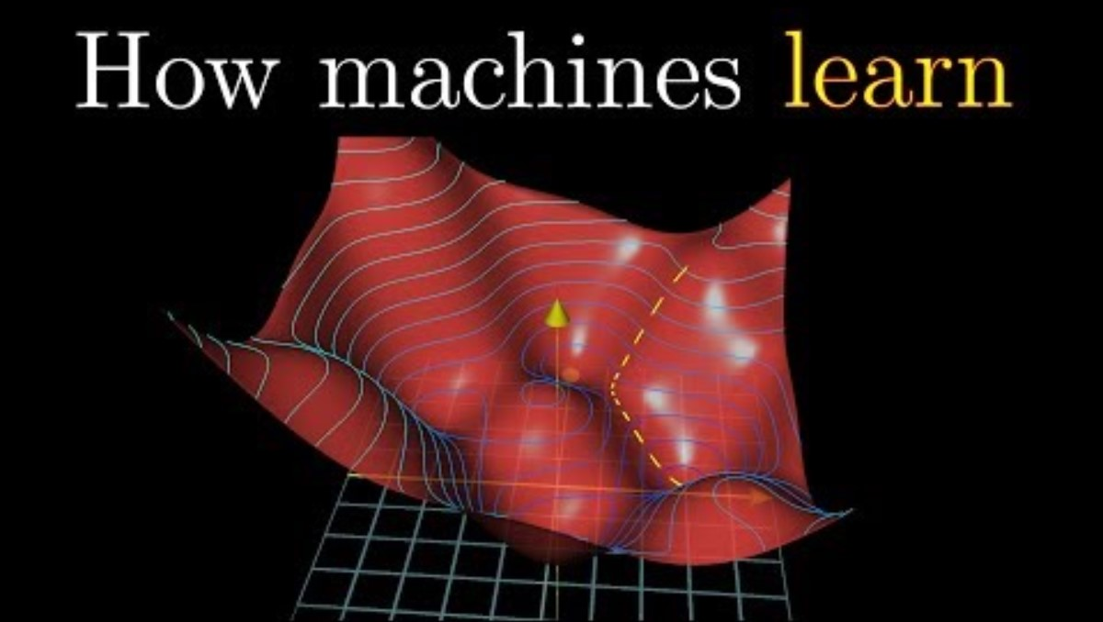

Slide 13
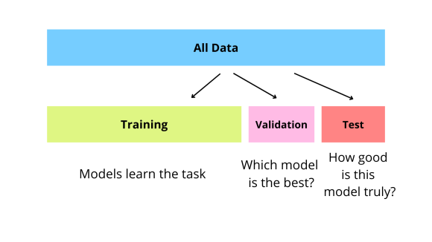
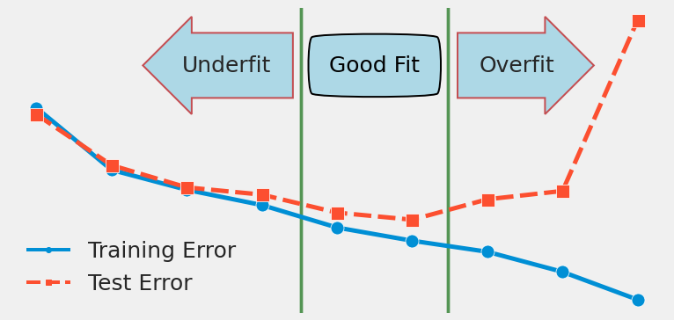
Measure Performance

Slide 14
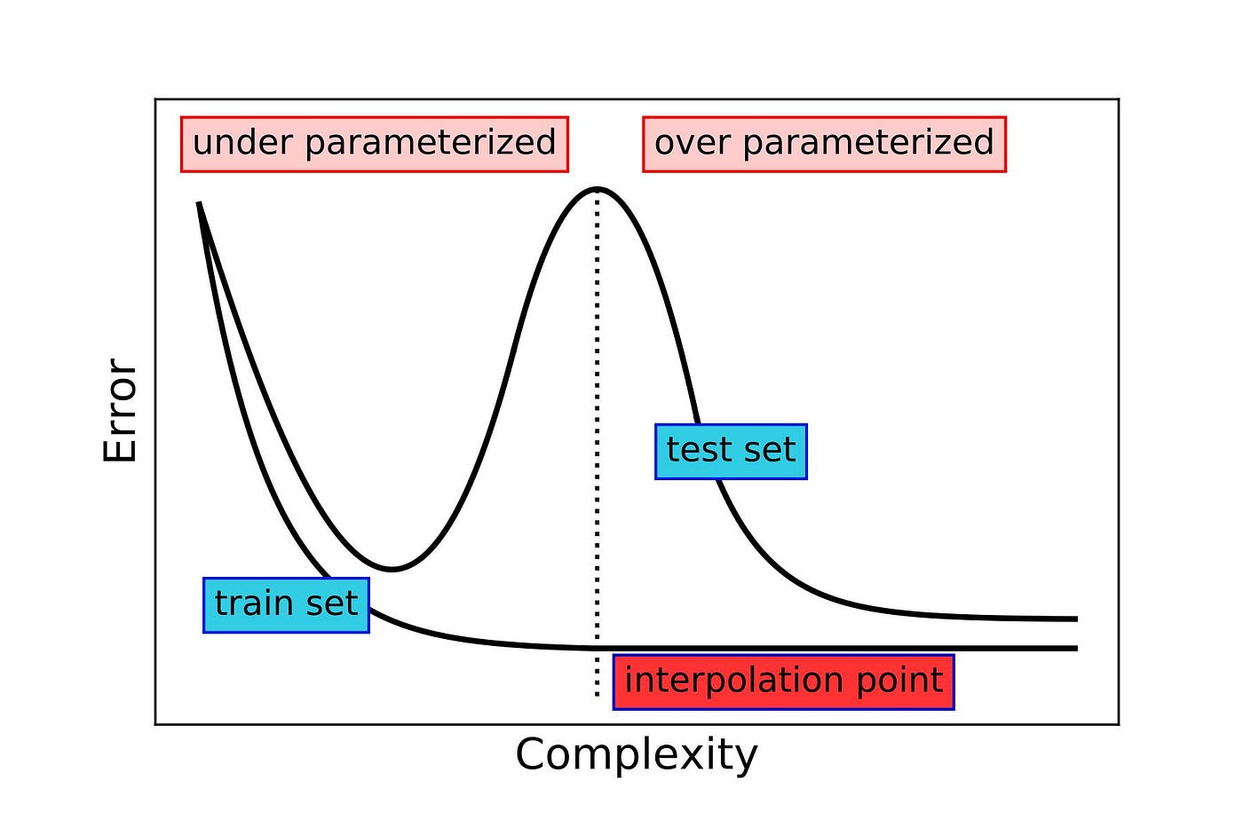
“Double Descent” in Overparametrization
Only happens under specific conditions:
Model is “overparametrized”
The “correct” solution is favoured by the Optimizers Inductive Biases

Slide 15
Most of Deep Learning research is collecting a bag of tricks to make this work better

Slide 16
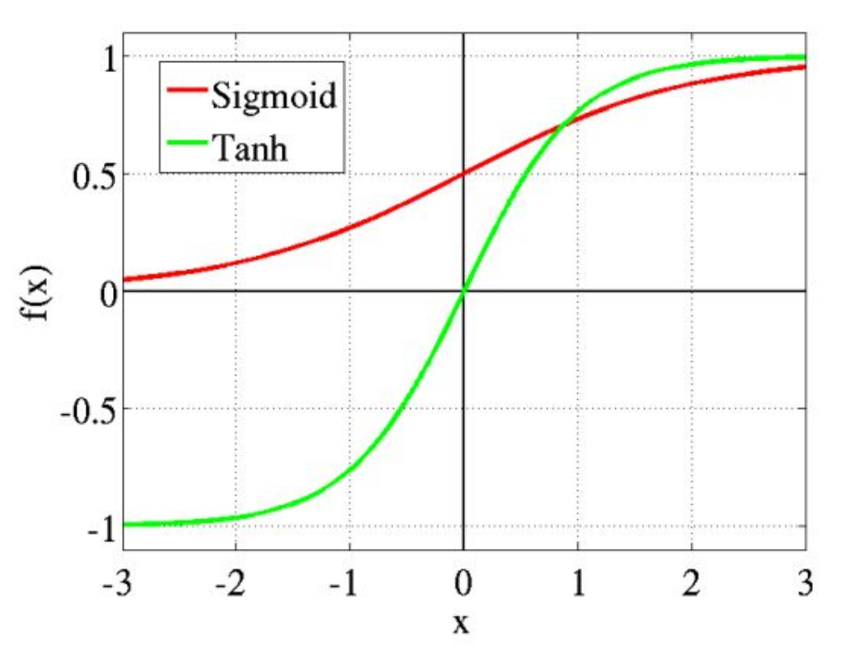
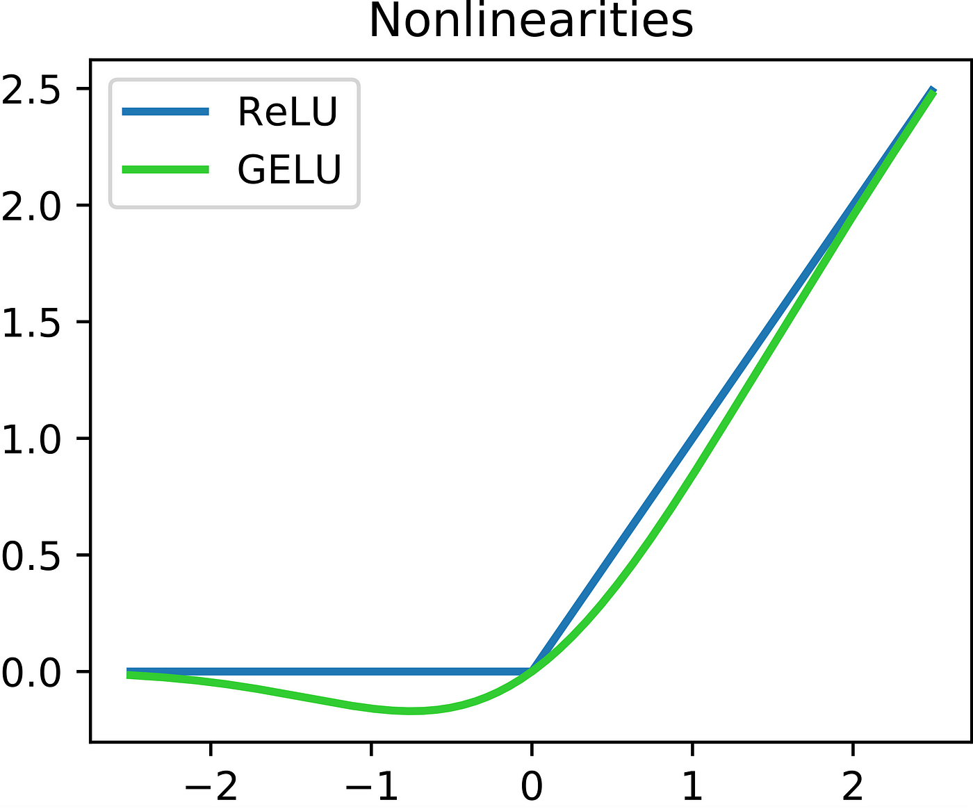
Activation functions
- Old activation Functions
- do the job of mapping arbitrary output to [0,1] in nonlinear way
- Extremal input leads to vanishing gradients
- Input functions used nowerdays
Less vanishing gradients
GELU empirically works robustly

Slide 17
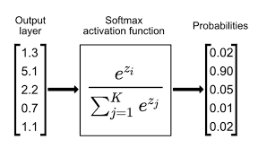
Softmax: from activations to probabilites
Any output gets normed
Activations are interpreted as something like logprobs
This is good for preserving gradients
Linear relationship from activation to “evidence”
0 activation != 0 probability

Slide 18
Batching
Not updating on single datapoints
Intuitively:
If the single datapoint is the pircture of an 8, the main update will be to predict “8” no matter the input.
If you aggregate gradients from many inputs, the main update will be something you actually want to learn
This also enables better parallel processing: Datapoints in one Batch can be computed in parallel

Slide 19
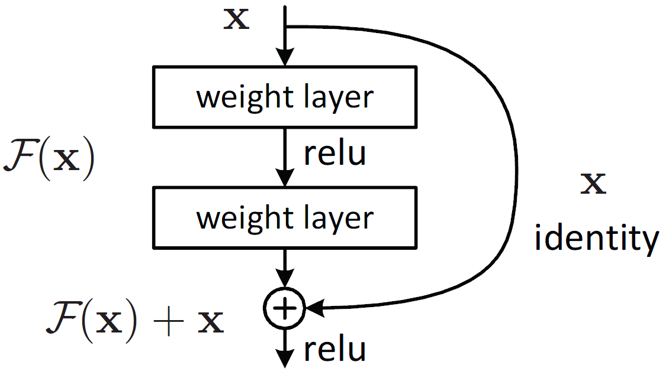
Residual connections
“shortcuts” through the computational graph
Gradients don’t vanish in previous layers, if they vanish in one layer
Another way to look at it: layers only read/write to the “Residual Stream” instead of successively operating on an activation

Slide 20
Dropout
In training, randomly ablate some of the weights
This is typically not done in “deployment”
Results are more robust, depend less on individual neurons
Learned features become redundant
Reduces overfitting

Slide 21
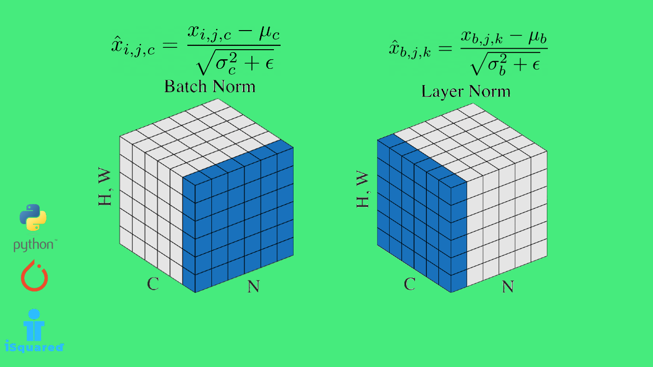
Normalizations
Often, the value of the activation of a Neuron is less relevant than their relative activation
Here, se can recentre the distribution of activations

Slide 22
Optimizers
The simplest Gradient Descent Step we can do, is add a bit of the gradient to the weight
However, there are many smarter ways of doing that
These considerations of how to do that are so central to ML, that we will spend a whole Kursschiene on this tomorrow

